Slide 1
Chapter 14 Introduction to Collections
Fundamentals of Java: AP Computer Science Essentials, 4th Edition
Lambert / Osborne

Slide 2
Objectives
Recognize different categories of collections and the operations on them
Distinguish between a collection’s interface and its implementing classes
Use list, stack, queue, set, and map collections to solve problems
Choose a particular collection implementation based on its performance characteristics
‹#›
‹#›

Slide 3
Vocabulary
association list
collection
dictionary
hashing
iterator
keyed list
list
map
queue
set
stack
table
type parameter
type variable
wrapper class
‹#›
‹#›

Slide 4
Overview of Collections
Collection: a group of items treated as a conceptual unit.
Strings and arrays are collections of characters and elements.
Can be homogenous: all items of the same type.
Or heterogeneous: items of different types.
Important characteristic of collections is how they are organized.
‹#›
‹#›

Slide 5
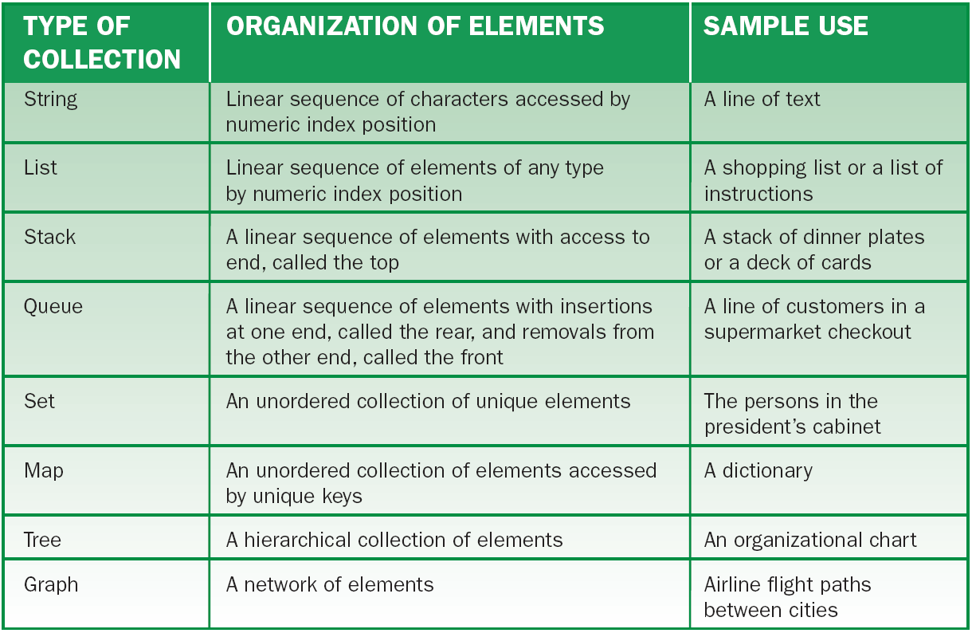
Overview of Collections (continued)
Types of collections
‹#›

Slide 6
Overview of Collections (continued)
Operations on Collections:
Typically dynamic, not static.
Can grow or shrink with the needs of the problem.
Contents can change throughout a program.
Similar operations can be performed on arrays.
Take a logical perspective on elements, such as with an array of strings. Want to use method that apply to strings not arrays.
Collections are more abstract than arrays.
‹#›
‹#›

Slide 7
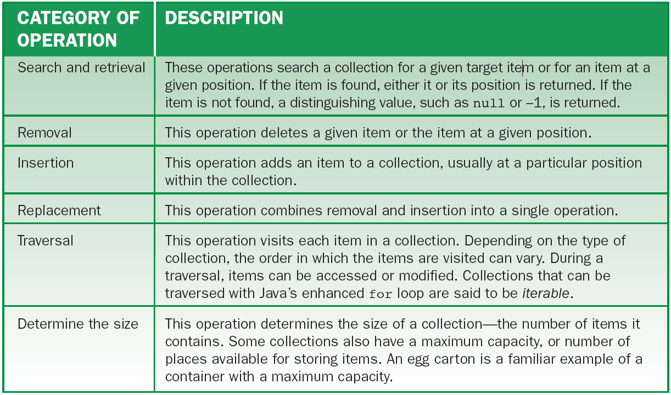
Overview of Collections (continued)
Operations on Collections (cont):
Categories of operations on collections
‹#›

Slide 8
Java Collection Resources
Defined in the package java.util.
Set of interfaces that specify operations for different type of collections.
Set of classes that implement the interfaces.
An interface provides a logical view of the behavior of a class of objects.
Programmers who use lists develop logic using the List interface, then use criteria such as run-time performance to select an implementing class.
‹#›
‹#›

Slide 9
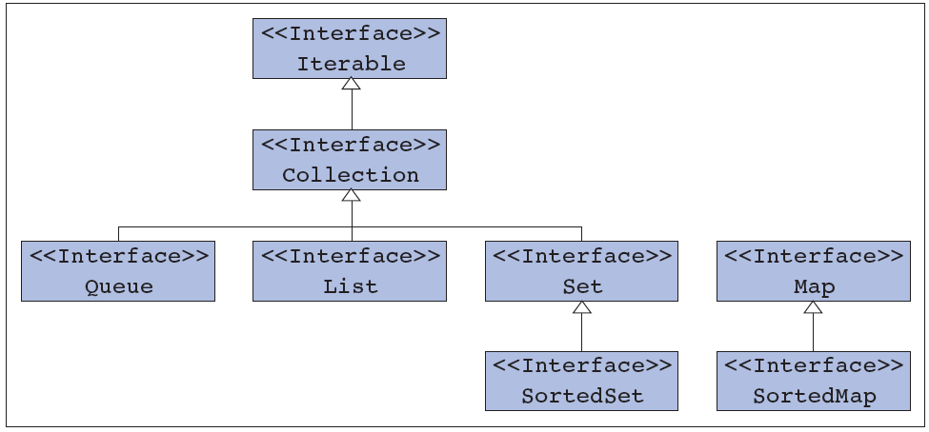
Java Collection Resources (continued)
The Java Collection Interfaces:
The java.util collection interfaces
‹#›
‹#›

Slide 10
Java Collection Resources (continued)
The Java Collection Interfaces (cont):
Hierarchy includes two general interfaces: Collection and Iterable.
Implement methods included in the Collection interface.
Map does not extend Collection.
Collection extends Iterable.
Requires every implementing class to include an iterator method.
‹#›
‹#›

Slide 11
Java Collection Resources (continued)
The Java Collection Classes:
The java.util class also includes implementing classes for lists, sets, maps, sorted sets, sorted maps, and queues.
Programmers choose a collection class based on:
Logic of an application.
A collection’s run-time performance.
‹#›
‹#›

Slide 12
Using Lists
Lists and arrays are both:
Objects that contain a sequence of elements ordered by an integer index position.
Elements can be both accessed and replaced.
‹#›
‹#›

Slide 13
Using Lists (continued)
Lists are unlike arrays:
Programmer must use methods rather than the subscript operator [ ] to manipulate list items.
Lists track both logical and physical size.
When first created, a list’s logical size is 0. The list updates its logical size as elements are added to or removed from the list.
The index positions for access in a list range from 0 to its logical size minus 1.
‹#›
‹#›

Slide 14
Using Lists (continued)
The List Interface:
Includes a large number of methods:
Boolean isEmpty(), int size(), etc.
The methods get, set, and the first add and remove methods are index-based.
Access an index position in the list to perform a task.
Methods in the List interface show an element type named E or Object to indicate that the element type is generally an object.
‹#›
‹#›

Slide 15
Using Lists (continued)
The List Interface (cont):
Type variable: when a name such as E is used to specify a type in an interface.
Type parameter: when a name such as String replaces the type variable during instantiation.
Declaring and Instantiating a List:
A list is an object and must be instantiated.
Don’t use an interface name for a type name.
Physical length is not specified.
‹#›
‹#›

Slide 16
Using Lists (continued)
Using List Methods:
The programmer manipulates a list by sending it messages.
Methods include: examining logical size; testing for emptiness; inserting, removing, examining, replacing and searching for elements, etc.
‹#›
‹#›

Slide 17
Using Lists (continued)
Lists and Primitive Types:
Unlike arrays, lists can contain only objects, not values of primitive type, such as int or double.
Primitive Types and Wrapper Classes:
Wrapper class: used to store primitive data types in a list.
A class that contains a value of primitive type.
Use the appropriate wrapper class name as the element type parameter.
‹#›
‹#›

Slide 18
Using Lists (continued)
Iterators:
Iterators are objects that allow the programmer to visit all of the elements in a collection.
The simplest iterator type supports the methods in the java.util.Iterator interface.
The programmer opens an iterator object by running the iterator method.
The iterator’s current position pointer is placed before the first object, if the collection isn’t empty.
‹#›
‹#›

Slide 19
Using Lists (continued)
Iterators (cont):
The programmer then tests to determine if there are elements to visit.
Sends the hasNext() message.
The message returns the element to the caller and advances the iterator’s current position to just beyond the first element.
Repeat steps to visit all of the elements in a collection.
‹#›
‹#›

Slide 20
Using Lists (continued)
Iterators (cont):
When the compiler sees an enhanced for loop with a collection, it generates code that opens an iterator on the collection and carries out the loop process.
Because a for loop is easier to use, programmers don’t use an explicit iterator unless a collection’s elements need to be removed.
‹#›
‹#›

Slide 21
Using Lists (continued)
Confusing Arrays and Lists:
Lists are accessed using methods; arrays are accessed using subscripts.
Should I Use Arrays or Lists?:
Lists are more powerful and easier to use.
Lists include methods for tasks such as insertions, removals, and searches.
Lists track logical size and grow or shrink automatically.
‹#›
‹#›

Slide 22
Using Lists (continued)
Should I Use Arrays or Lists? (cont):
Arrays could be used interchangeably with lists in some situations:
You know the exact number of data elements to be inserted in advance, and they are known at startup, and never removed.
The operations on the sequence are more specialized that those provided by a list, or consist of simple traversals.
‹#›
‹#›

Slide 23
Using Lists (continued)
Linked Lists:
LinkedList class can be used wherever ArrayList is used.
Array lists and linked lists are logically the same, but differ in run-time characteristics.
Array lists run in constant time.
Linked lists run in linear time.
LinkedList class includes methods for accesses, insertions, and removals.
‹#›
‹#›

Slide 24
Using Stacks
Stack: a sequence of elements in which access is restricted to the top end.
LIFO (Last In First Out) protocol.
The Stack Class:
A subclass of Vector, which implements List and Collection.
A stack’s element type should be specified when created.
‹#›
‹#›

Slide 25
Using Stacks (continued)
Applications of Stacks:
Analyzing and checking syntax of expressions.
Translating infix expressions to postfix form.
Evaluating postfix expressions.
Backtracking algorithms used in problems.
Managing computer memory in support of method calls.
‹#›
‹#›

Slide 26
Using Stacks (continued)
Applications of Stacks (cont):
Supporting the undo feature in text editors and other applications.
Maintaining a history of links visited by a Web browser.
‹#›
‹#›

Slide 27
Using Stacks (continued)
Example: Evaluating Postfix Expressions:
Infix: requires parentheses, involves rules of precedence.
Postfix: no parentheses, applies operators as encountered.
Scan expression from left to right.
On encountering an operator, apply it to the two preceding operands on and replace all three with the result.
Continue scanning until the end of expression, at which point only the expression’s value remains.
‹#›
‹#›

Slide 28
Using Stacks (continued)
Scanning Expressions:
Although scanning from left to right sounds simple, it is not.
Input datum is typically a line of text (string).
Algorithm must detect and extract operators and operands. Operands must be converted to int.
The Scanner class provides the capability of recognizing and extracting works or tokens.
‹#›
‹#›

Slide 29
Using Queues
Queue: A sequence of elements.
Insertions are restricted to the rear end.
Removals are restricted to the front end.
FIFO (First In First Out) protocol.
The Queue Interface and Its LinkedList Implementation:
Queues have two fundamental operations:
add (inserts item into rear); remove (removes and returns item from the front).
‹#›
‹#›

Slide 30
Using Queues (continued)
The Queue Interface and Its LinkedList Implementation (cont):
LinkedList class implements the Queue interface, so the compiler can restrict the programmer’s use of methods to those in Queue and Collection.
Using interface names when declaring variables protects the programmer from doing things that should not be done with certain types of object.
‹#›
‹#›

Slide 31
Using Queues (continued)
Applications of Queues:
Processes are queued for access to a shared CPU.
Processes are queued for access to a shared secondary storage device (disk).
Print jobs are queued for access to a shared printer.
Computer simulations are used to study behavior of real-world systems.
‹#›
‹#›

Slide 32
Using Sets
Set: a collection of items that are unique.
Operations include:
Test for empty set.
Return number of items in a set.
Add or remove items.
Return the union (a set that contains all of the items of both sets) of two sets.
‹#›
‹#›

Slide 33
Using Sets (continued)
Operations include (cont):
Return intersection (set of items that are in both sets) of two sets.
Return difference (set of items in one that are not in the other) of two sets.
Test a set to determine if another set is a subset (either empty or all subset items are in the other set).
‹#›
‹#›

Slide 34
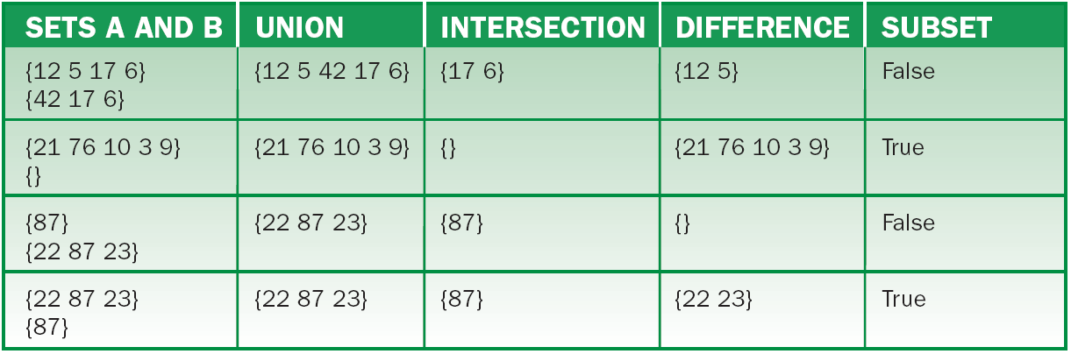
Using Sets (continued)
Results of typical set operations
‹#›

Slide 35
Using Sets (continued)
The java.util.Set Interface:
The set supports an iterator method, used to examine all the items in a set after they have been added since sets are not index-based.
Implementing Classes:
HashSet and TreeSet.
Hashing: technique for accessing set items.
‹#›
‹#›

Slide 36
Using Maps
Maps: collections in which each item or value is associated with a unique key.
Also called: tables, keyed list, dictionary, and association list.
Dictionary, HashTable, HashMap, and TreeMap.
Keys can be in any order, but must be unique. The same value can be associated with more than one key.
‹#›
‹#›

Slide 37
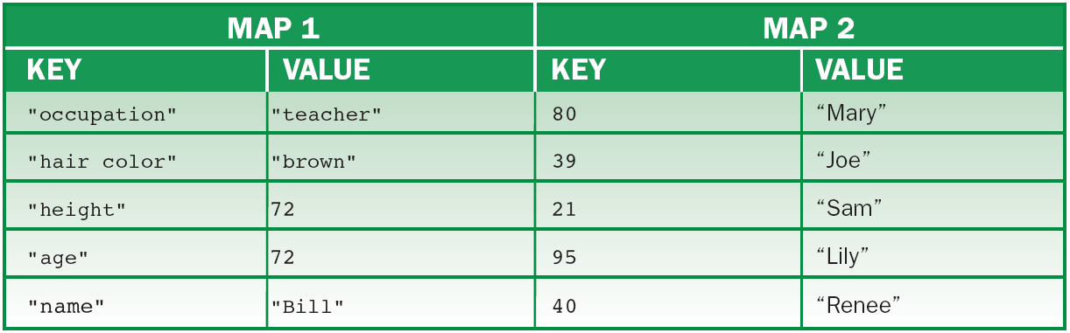
Using Maps (continued)
A map keyed by strings and a map keyed by integers
‹#›

Slide 38
Using Maps (continued)
Clients should be able to do the following:
Test a map for emptiness.
Determine a map’s size.
Insert or retrieve a value at a given key.
Remove a given key and its associated values.
Determine whether a map contains a key or a value.
Examine all of the keys and values.
‹#›
‹#›

Slide 39
Using Maps (continued)
An object associated with a key is its value.
A map uses two type variables (K and V) to refer to key and value types.
You can open an iterator on a collection to visit all the keys and values in the map.
A map needs two type parameters (key and value) when it is declared and instantiated.
An object’s key can be one of its attributes.
‹#›
‹#›

Slide 40
The Glue That Holds Collections Together
All collections contain objects, have a definite size at any given time, and can grow or shrink in time.
There are operations that they have in common.
Addition, Removal, and Membership:
Collections have different methods for addition and removal
index- or object-based.
position-based via an iterator.
‹#›
‹#›

Slide 41
The Glue That Holds Collections Together (continued)
Addition, Removal, and Membership (cont):
Also include the contains method to test an object for membership in the collection.
Iterators: work the same way with lists, sets, and maps.
Other Operations:
Remove all elements to empty a collection.
Add or remove elements of one collection to another.
‹#›
‹#›

Slide 42
The Glue That Holds Collections Together (continued)
Other Operations (cont):
Retain only the elements of one collection that are present in another.
Determine whether one collection contains all the elements in another collection.
The java.util.Collection Interface:
Some operations are optional (include methods, but don’t have to support them).
Several expect a parameter of type Collection.
‹#›
‹#›

Slide 43
The Glue That Holds Collections Together (continued)
The Collections Class:
The programmer can write new methods for almost any occasion because of the variety of operations in collections.
Searching, maximum value, sorting, etc.
Each of the method signatures starts with the static modifier, which sends the message to the Collections class, not to any instance.
‹#›
‹#›

Slide 44
Summary
In this chapter, you learned:
Collections are container objects that organize a number of data elements in a program.
Collections typically grow or shrink in size with the needs of a program.
Lists, stack, queues, sets, and maps are types of collections that support special-purpose access to their elements.
‹#›
‹#›

Slide 45
Summary (continued)
A list is a linear sequence of elements that are accessed by position.
A stack is a linear sequence of elements that are accessed at one end, called the top.
A queue is a linear sequence of elements that are added at one end and removed at the other end.
A set is an unordered collection of unique elements.
Sorted sets and maps allow programmers to visit their elements in sorted order.
‹#›
‹#›

Slide 46
Summary (continued)
An iterator is an object that allows the programmer to traverse the elements in a collection.
The logical behavior of a collection is specified in its interface.
Programmers can choose among different classes that implement the same collection interface. This choice depends on the run-time performance of the implementing class.
‹#›
‹#›

